Slide 1
Gurian Institute Success Data Over Twenty-Five Years
*This brief power point graphically illustrates success data from various schools serving children of all ages.
*We first deployed GI interventions in the late 1990s, in six school districts in Missouri. Those success results were peer-reviewed and published in Boys and Girls Learn Differently (Jossey Bass/John Wiley: San Francisco, 2000, 2010).
*For more detail and more success data, please visit the Success pages of www.gurianinstitute.com.
*To bring our programs and training to your school or district, please write us at info@gurianinstitute.com.
Notes:
11-Boys
9-Girls

Slide 2
It should be noted that total fights on campus declined 76% from 125 to 30.
Demographics are 65% Hispanic, 25% White, 8% Black, and 2% Other.

Slide 3
Boy Reading-Gap Decreased by 60%
Avoca School District is in Illinois

Slide 4
Percent of Students Proficient or Advanced in Language Arts using Gurian Success Model at Pine Tree Elementary in Indiana (A Title 1 School) 2007 to 2011
Percent of Students Proficient or Advanced in Math using Gurian Success Model at Pine Tree Elementary in Indiana (A Title 1 School) 2007 to 2011
*ISTEP is the Indiana Statewide Testing for Educational Progress
*ISTEP is the Indiana Statewide Testing for Educational Progress

Slide 5
Percent of Students Proficient or Advanced in Language Arts using Gurian Success Model at Pine Tree Elementary in Indiana (A Title 1 School) 2007 to 2011
*ISTEP is the Indiana Statewide Testing for Educational Progress

Slide 6
Percent of Students Proficient or Advanced in Math using Gurian Success Model at Pine Tree Elementary in Indiana (A Title 1 School) 2007 to 2011
*ISTEP is the Indiana Statewide Testing for Educational Progress

Slide 7
Percent of Student Meeting Academic Progress in Reading using Gurian Success Model from 2007 to 2011 on the NWEA* at Pine Tree Elementary**
Percent of Student Meeting Academic Progress in Math using Gurian Success Model from 2007 to 2011 on the NWEA* at Pine Tree Elementary**
*“We also measure academic progress using the Northwest Evaluation Association (NWEA), which we give three times per year. We look at the percentage of students meeting their target RIT by spring for our second, third, and fourth grade students. What follows is the improvement we’ve seen on NWEA.”
**Pine Tree Elementary is a Title 1 school.
*“We also measure academic progress using the Northwest Evaluation Association (NWEA), which we give three times per year. We look at the percentage of students meeting their target RIT by spring for our second, third, and fourth grade students. What follows is the improvement we’ve seen on NWEA.”
**Pine Tree Elementary is a Title 1 school.

Slide 8
*“We also measure academic progress using the Northwest Evaluation Association (NWEA), which we give three times per year. We look at the percentage of students meeting their target RIT by spring for our second, third, and fourth grade students. What follows is the improvement we’ve seen on NWEA.”
**Pine Tree Elementary is a Title 1 school.

Slide 9
Percent of Student Meeting Academic Progress in Math using Gurian Success Model from 2007 to 2011 on the NWEA* at Pine Tree Elementary**
*“We also measure academic progress using the Northwest Evaluation Association (NWEA), which we give three times per year. We look at the percentage of students meeting their target RIT by spring for our second, third, and fourth grade students. What follows is the improvement we’ve seen on NWEA.”
**Pine Tree Elementary is a Title 1 school.

Slide 10
Franklin is a single sex school and 66% boys of color.

Slide 11
Franklin is a single sex school and 66% boys of color.

Slide 13
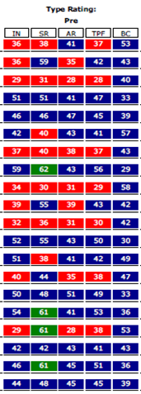
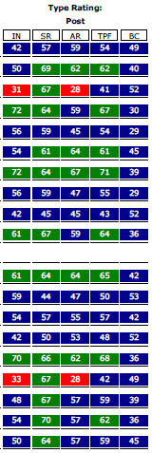
e-DECA (Cartwright, Preschool), Phoenix Head Start Pilots 2020, Before/After Data
Notice all the Red Indicators
(Concerns)
Less Red Indicators more Strengths
August-February
After Gurian training and coaching implementations.
Notes:
11-Boys
9-Girls

Slide 14
School Readiness Goals, Preschool, Head Start, 2021
*Time 1 data (October) includes all CECC and Barry Gurian Pilot sites with a total of 87 children with enough Gold data to include in the report.
*Time 2 data (February) includes all ASU Prep, CECC and Barry Gurian sites with a total of 103 children.

Slide 15
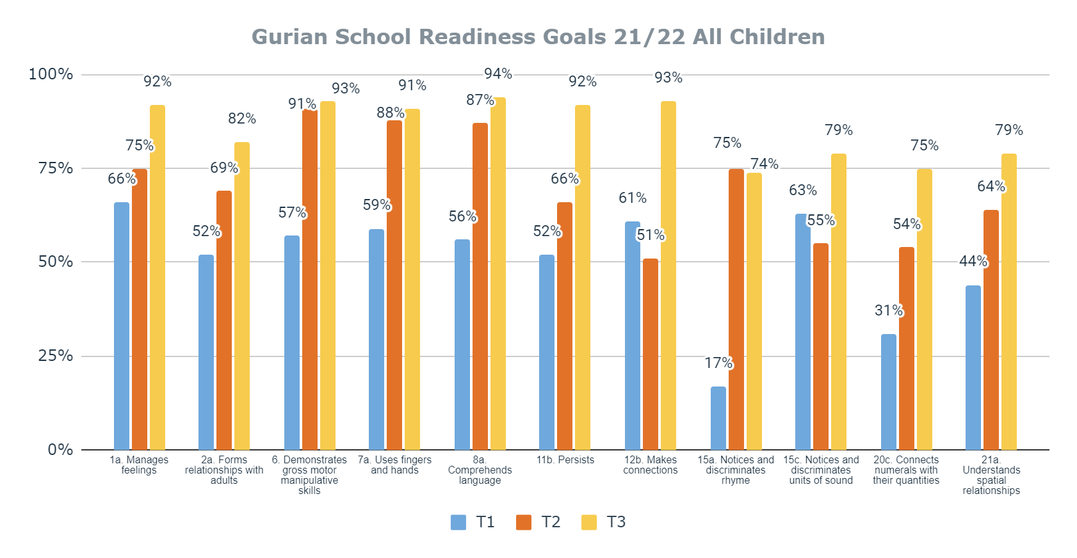
Time 1 (October): 164 Children
Time 2 (February): 184 Children
Time 3 (May): 206 Children
T1 Sites:
Barry 5, 6, 15 am/pm, 16 & 18 am/pm
ASU Central & ASU South
CECC 26, 27, 28, 29, 30, 31 & 32
T2 Sites:
Barry 5, 6, 16 & 17
ASU Central & ASU South
CECC 26, 28, 29, 30, 31 & 32
T3 Sites:
Barry 5, 6, 16 & 17
ASU Central & ASU South
CECC 26, 28, 29, 30, 31 & 32

